Slide 1
Recognition of Pulmonary Diseases based on Lung Sounds using Deep Learning
Batch:C15
Presented by:
V. Pujitha[Y20ACS582]
R.Sireesha[Y20ACS541]
S.Subrahmanya Manikanta [L21ACS420]
Sk.Baji[Y19ACS560]
Under the Guidance:
Dr. R. VENKATA LAKSHMI
Ph.D

Slide 2
CONTENTS
Abstract
Existing system
Proposed system
Design
Implementation
Results
Conclusions

Slide 3
ABSTRACT
Large number of people die every year of Pulmonary chronic lung diseases irrespective of their age.
Lung sound analysis has been a key diagnostic aid to accurately detect Pulmonary Diseases.
Earlier, manual detection was used which was not a dependable method to detect lung diseases due to various reasons like low audibility and difference in perceptions of different physicians for different sounds.
Modern computerized analysis yield results with much higher accuracy.
In general, the analysis is carried out through characterization of waveform of the filtered lung sound.
The deep learning network architecture consisted of two stages; convolutional neural networks and bidirectional long short-term memory units.

Slide 4
Existing System
The Existing system represents a novel approach in the realm of deep learning architectures for signal processing, particularly in the domain of disease recognition using lung sound signals.This integration is achieved by combining Convolutional Neural Network (CNN) and Bidirectional Long Short-Term Memory (BDLSTM) models.
A deep learning model based on convolutional neural networks (CNNs) and bidirectional long short-term memory (LSTM) was utilized for the purpose of lung sounds classification. The classification of lung sounds into multiple respiratory diseases using this model had an overall average accuracy of 89 %. This study paves the way towards implementing deep learning trained models in clinical settings to assist clinician in decision making.
While some misclassification occurs, particularly with signals from chronic obstructive pulmonary disease (COPD) patients being misclassified as normal or asthma, the overall detection error for each disease remains low.

Slide 5
Proposed system
For construction of the neural network model we have used five types of layer:
Gated Recurrent Unit(GRU)
Leaky Relu(Leaky version of a Rectified Linear Unit)
Dense Layer
Dropout
Add layers
Modern computerized analysis yield results with much higher accuracy

Slide 6
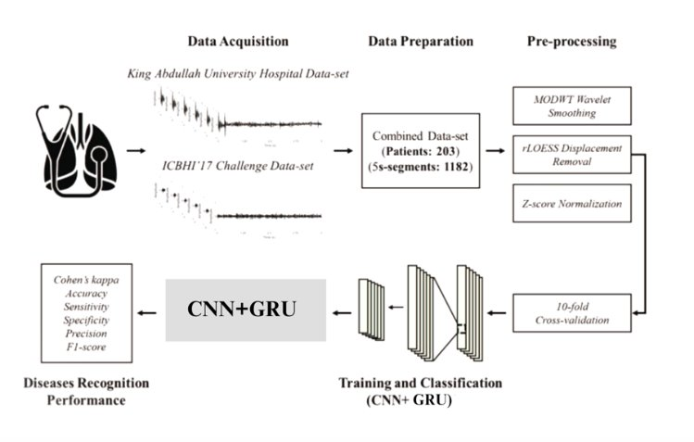
DESIGN

Slide 7
IMPLEMENTATION
Problem Definition and understanding
Data Collection and Preparation
Model Selection
Model Training
User Interface Development
Documentation and Knowledge Transfer
Testing and Validation
Final System Deployment

Slide 8
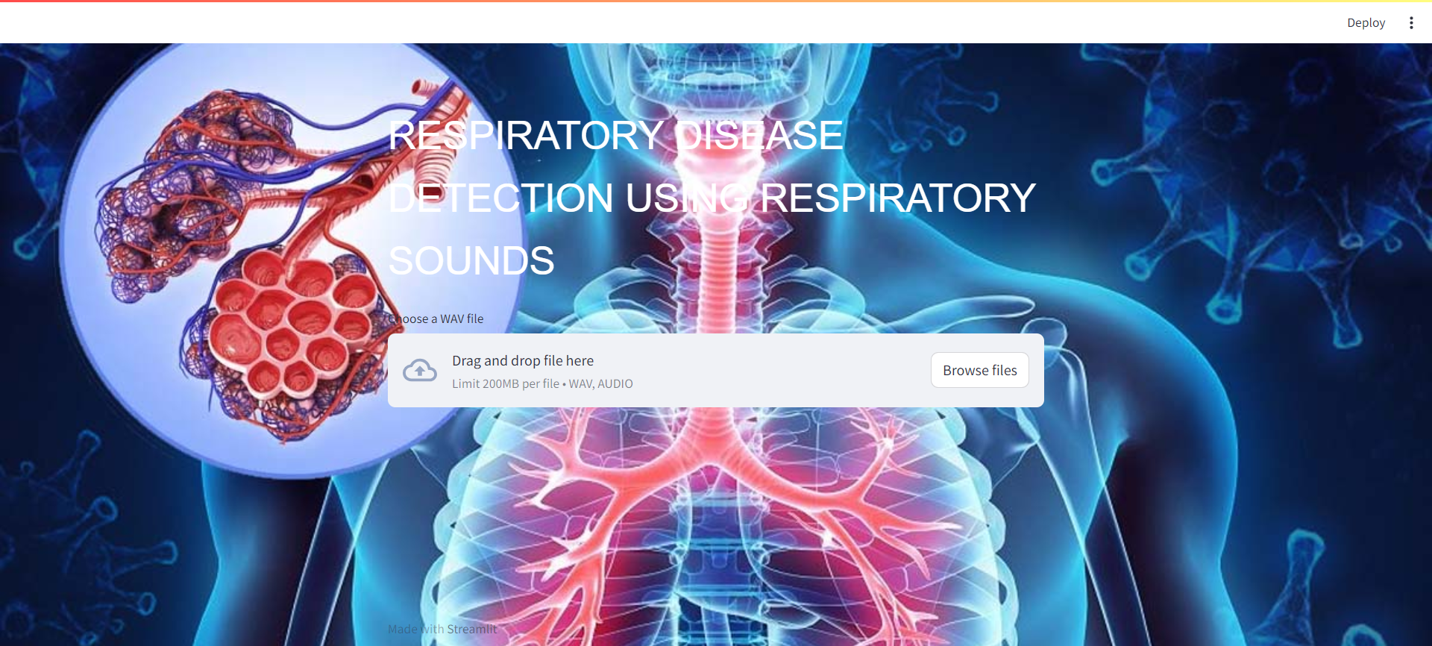
RESULT

Slide 9
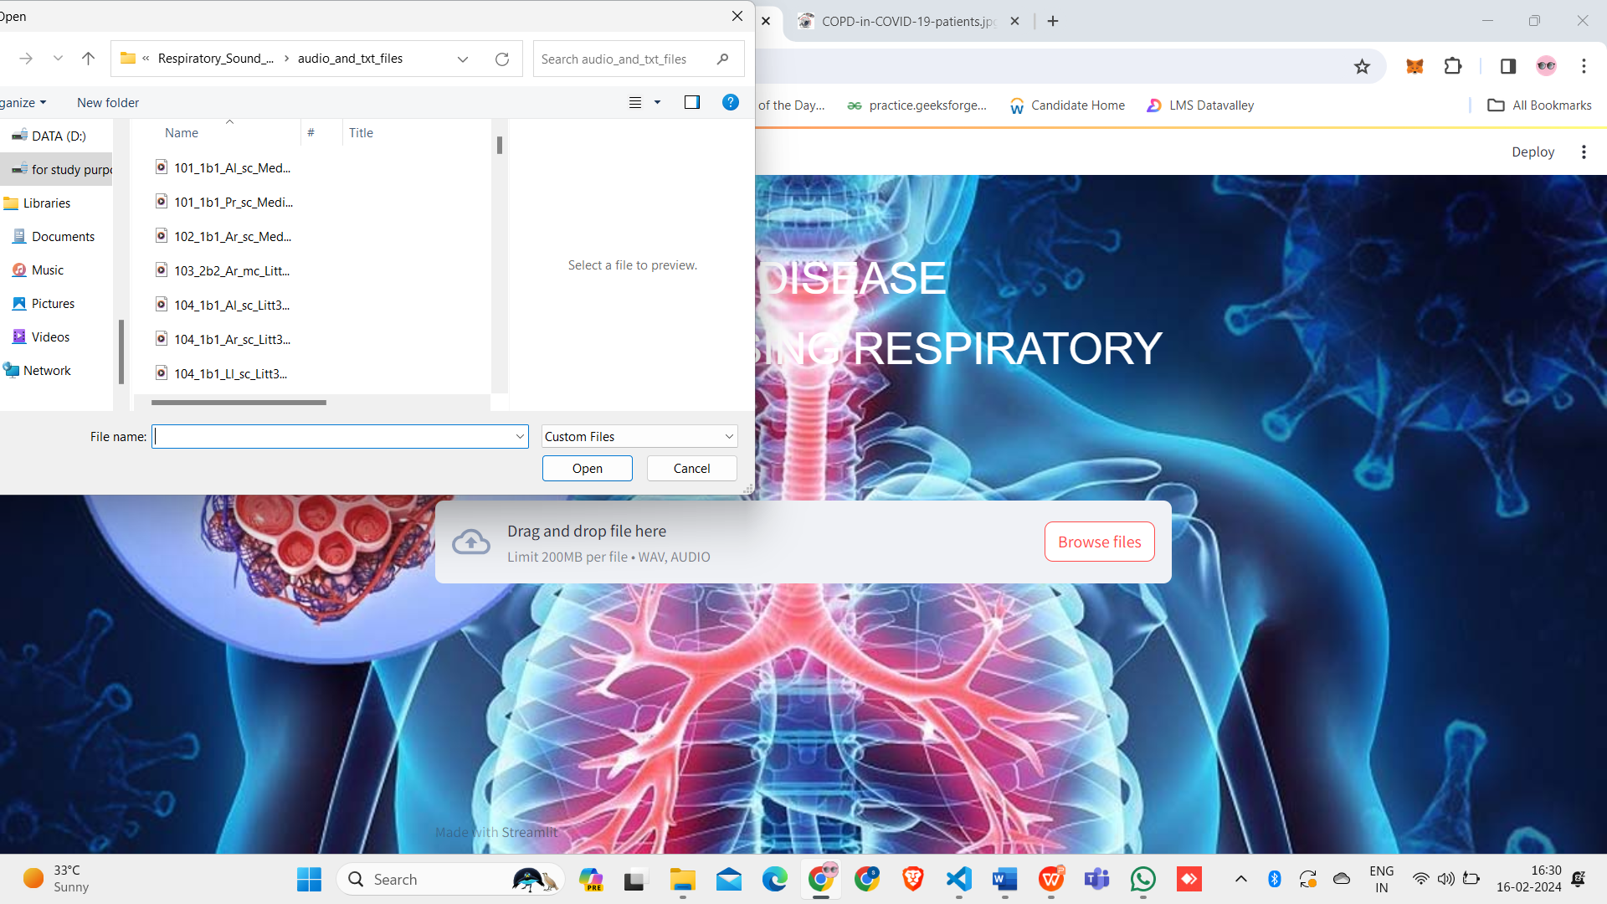

Slide 10


Slide 11
CONCLUSION
A deep learning model based on convolutional neural networks (CNNs) and Gated Recurrent Unit(GRU) was utilized for the purpose of lung sounds classification. The classification of lung sounds into multiple respiratory diseases using this model had an overall average accuracy of 98.62% with a Cohen’s kappa value of 98.26%. This study paves the way towards implementing deep learning trained models in clinical settings to assist clinician in decision making.

Slide 12
THANK YOU

